Slide 1

TOPIC 6: PROMOTION
https://keap.com/business-success-blog/sales/e-commerce/26-best-examples-of-sales-promotions-to-inspire-your-next-offer

Slide 2
Promotion and communication
Promotion is fourth element of the marketing mix and is based on the principles of general communication, namely the sharing of meaning through the transmission of information using a common set of symbols (language, facial expressions, pictures, sounds, etc).
Marketing communication includes all the messages, media, and activities used by an organization to inform, persuade, and remind buyers and potential buyers of a product in order to influence their beliefs, get a response, and build a relationship. It is a two-way process that include feedback and reaction by buyers.

Slide 3
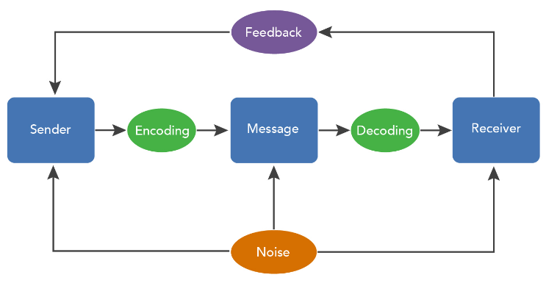
Communication model
https://s3-us-west-2.amazonaws.com/courses-images/wp-content/uploads/sites/4052/2019/04/08194200/CommunicationProcessModel3.jpg

Slide 4
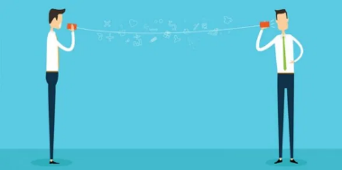
Elements of the communication process model
Sender
Business whose products have to be promoted.
Receiver
Audience at whom the message is directed.
https://eventualconsistency.com/2020/05/10/the-importance-of-communication/

Slide 5
Elements of the communication model
Message - The message is what the marketer wants to convey, using the message channel. The channel is the medium of transmission that carries the coded message from the source to the receiver.
Encoding - Converting the message into a symbolic form that is properly understood by the receiver.
Can be spoken or written words
Pictures (in magazines, on websites, TV, etc)
Body language and sounds
Decoding - Process of transforming received message back into concepts and ideas understood by the receiver.

Slide 6
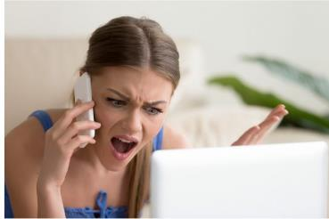
Activity: Message to be conveyed & encoding
Watch the video to see how a message can be encoded using body language and sounds
https://www.youtube.com/watch?v=bWaBPdAGpsI
Consumers also often also use body language and sounds (e.g. angry or friendly voice) to send messages back to marketers
https://intelligentdialogue.com/resource/dealing-angry-customers/

Slide 7
Activity: Receiving and decoding the message
A sent message will not result in effective communication unless the receiver understands the message and is able to interpret it.
The video provides an example of decoding a sent message.
https://www.youtube.com/watch?v=-PmiApKA4IU

Slide 8

Elements of the communication process model (continued)
Feedback: Response/non-response by the target market
Necessary to analyze the success of the communications effort (toll-free calls, click-throughs, coupons) based on feedback from the consumer.
https://courses.lumenlearning.com/wm-organizationalbehavior/chapter/the-process-of-communication/

Slide 9
Elements of the communication process model (continued)
Noise: Any distracting stimuli that interfere with the clear and accurate transmission and/or reception of the intended message.
Can you think of examples of noise, other than noise that can be heard?

Slide 10
Elements of the communication process model - Noise
Trying to convey a message in a language, pictures of symbols not understood by the target market will result in failed communication. Misunderstanding can be caused by language barriers which act as noise.
Follow the links if you want to try out some of South Africa’s 11 official languages.
https://www.youtube.com/watch?v=31zzMb3U0iY
https://www.youtube.com/watch?v=vhgb60Qsjrs

Slide 11
Promotion
Promotion is fourth element of the marketing mix and is based on the principles of general communication, namely the sharing of meaning through the transmission of information using a common set of symbols (language, facial expressions, pictures, sounds, etc).

Slide 12
Promotion
Watch the video and answer the questions below.
Also note the interrelationship between promotion and the other topics we have covered so far.
https://www.youtube.com/watch?v=qD4OgOoKXOA
Explain three objectives (aims) of promotion.
What is a promotional mix and what must be done to the elements of the mix and why?
Name and briefly explain five methods of promotion.
Name and explain five key factors that might influence promotional decisions.

Slide 13
Two categories of communication used for promotional purposes
Categories of
Communication
1.
Interpersonal
Communication,
such as
direct promotion,
personal selling
2.
Mass
Communication,
such as advertising,
public relations,
publicity,
sales promotion

Slide 14
1. Interpersonal communication: Personal selling & direct selling
Interpersonal process involving a seller’s promotional presentation conducted on a person-to-person (direct) basis with the buyer:
Door-to-door selling
Call centres
Parties, e.g Tupperware

Slide 15
2. Mass communication Advertising, Public Relations, Publicity & Sales promotion
Mass communication is usually one-way and impersonal (no face-to-face interaction and communication with the customer), often in the form of advertising.
Traditional media | More modern media
Television Radio Newspapers Magazines Brochures Direct mail Outdoor advertising, e.g. billboards, transit advertising (advertising in trains, busses, etc) Other, e.g. print on T-shirts | Internet Mobile Social media Video marketing QR codes Others?

Slide 16
Public relations (PR)
PR = A marketing function that tries to inform the public, influence their attitudes, or earn their understanding and acceptance
Public relations tools include
Written materials such as brochures, newsletters and annual reports
Corporate identity materials such as business cards and signs
Speeches
Event sponsorships
Special events

Slide 17
Publicity
Publicity and public relations are not the same. Publicity is just one aspect of public relations.
Publicity a news story type of communication about an organization and/or its products transmitted through a mass medium
Publicity-based public relations tools include
News release – a short piece of copy publicizing an event or product
Feature article – a manuscript of up to 3,000 words prepared for a specific publication
Captioned photograph – a photo with a brief description of its contents
Press conference – a meeting used to announce major news events
.

Slide 18
Sales promotion
Short term strategy to support other forms of promotion.
Watch the video and answer the questions.
https://www.youtube.com/watch?v=mqR5kXI3l4k
Name and explain 4 types of sales promotion methods. Include an example to support your explanation.

Slide 19
Activity: Promotion
Use the earlier activity dealing with Scoops Ice Cream and the context that you have created for Scoops as your case study, With that in mind, answer the questions below.
Think of the target market(s) that you have defined. Which elements(s) of the promotional mix would be most suitable to your target market(s)?
Why have you chosen these elements?
What is the major message you would like to convey to your target market?

Slide 20



Thank you! Dankie! Enkosi!
https://keap.com/business-success-blog/sales/e-commerce/26-best-examples-of-sales-promotions-to-inspire-your-next-offer

